Slide 2
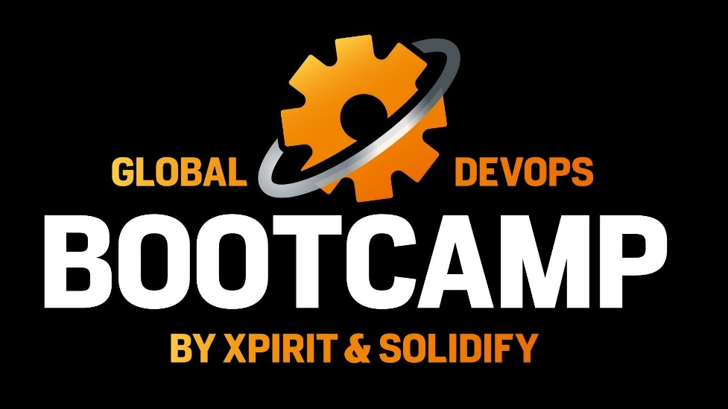
LifeCycle of DevOps: Complete Beginners Training
Manuel Sánchez - @Manuss20
Txema Gonzalez - @Tx_bals

Slide 3
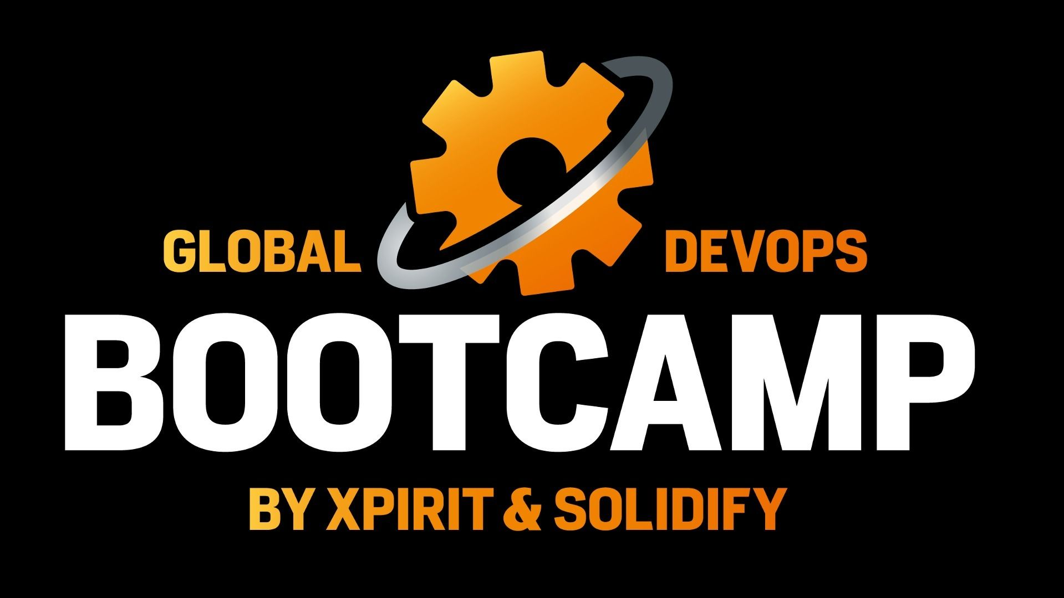
Agenda
Introducción a DevOps
¿Qué es DevOps?
Procesos
Implementación
Arquitectura

Slide 4


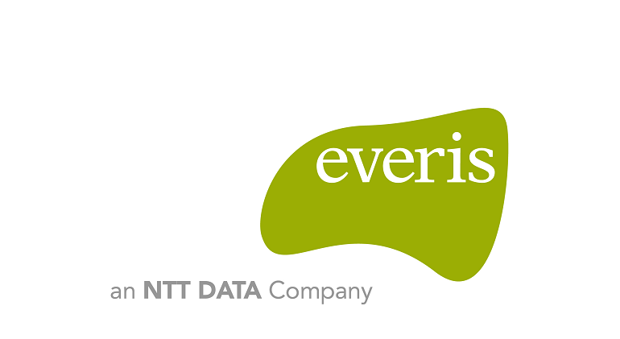
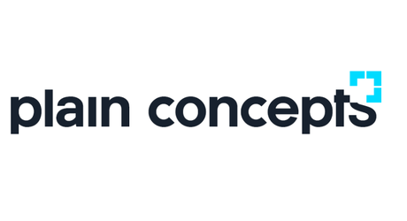
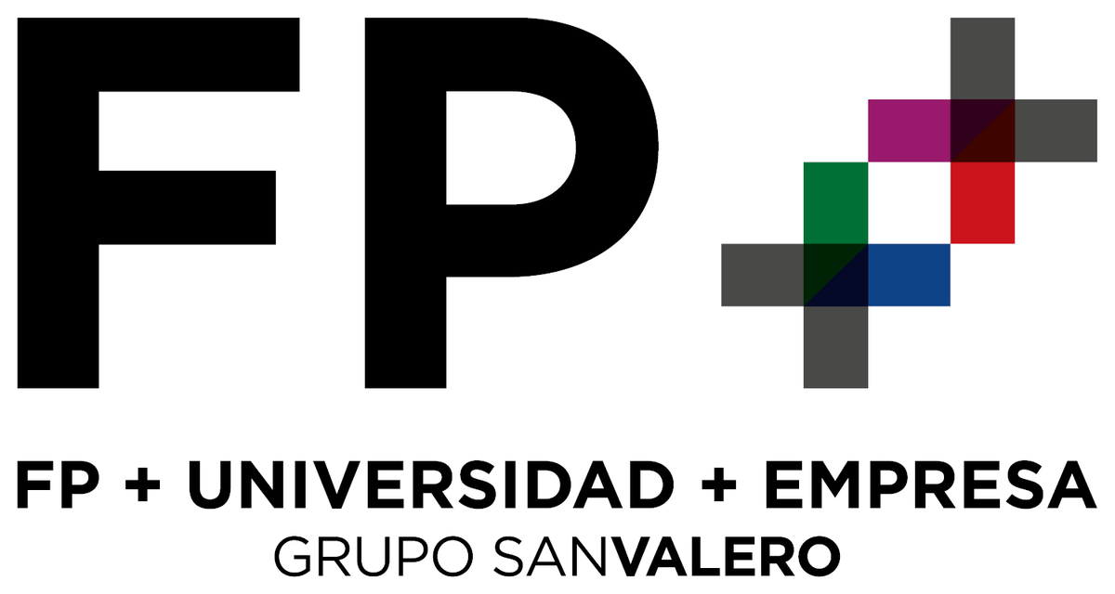
GRACIAS

Slide 5





Introducing Azure DevOps
Azure Boards
Azure Pipelines
Azure Repos
Deliver value to your users faster using proven agile tools to plan, track, and discuss work across your teams.
Build, test, and deploy with CI/CD that works with any language, platform, and cloud. Connect to GitHub or any other Git provider and deploy continuously.
Get unlimited, cloud-hosted private Git repos and collaborate to build better code with pull requests and advanced file management.
Azure Test Plans
Azure Artifacts
Test and ship with confidence using manual and exploratory testing tools.
Create, host, and share packages with your team, and add artifacts to your CI/CD pipelines with a single click.
Notes:
BOARDS: Es un trello,
PIPLINES: Automatice las compilaciones y las implementaciones con Pipelines para poder dedicar menos tiempo a estos procesos y más a crear.
TEST PLANS: Mejore la calidad del código con servicios de pruebas planeadas y exploratorias para sus aplicaciones
ARTIFACTS: Agregue administración de paquetes totalmente integrada a sus canalizaciones de integración y entrega continuas (CI/CD) con un solo clic. Cree y comparta fuentes de paquetes Maven, npm, NuGet y Python a partir de orígenes públicos y privados con equipos de cualquier tamaño.

Slide 6



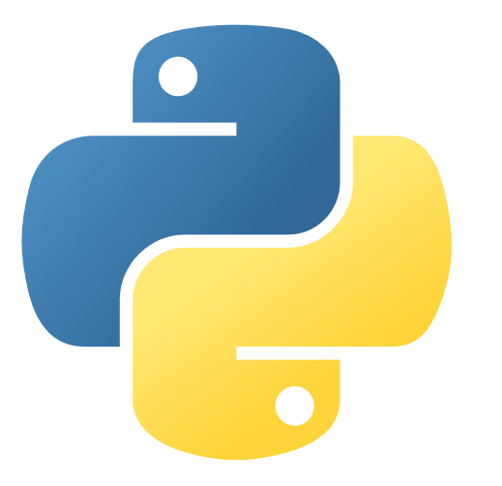
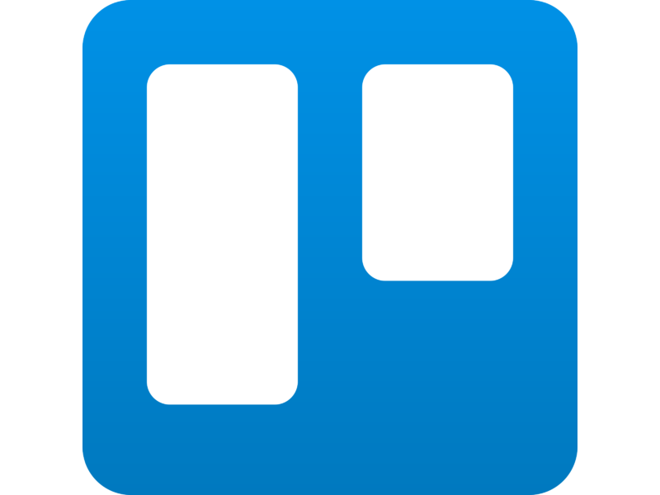
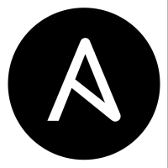

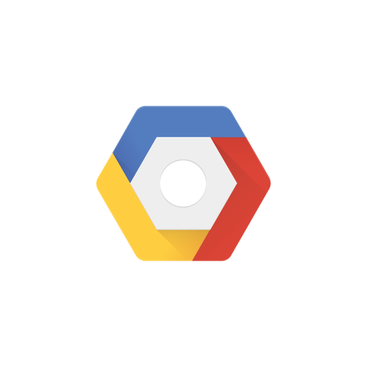

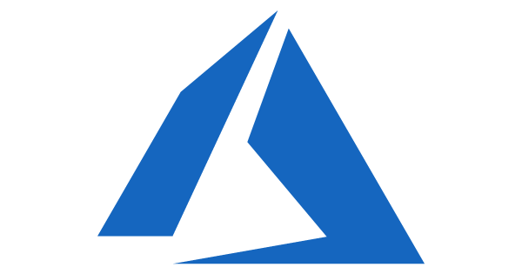

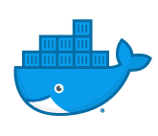
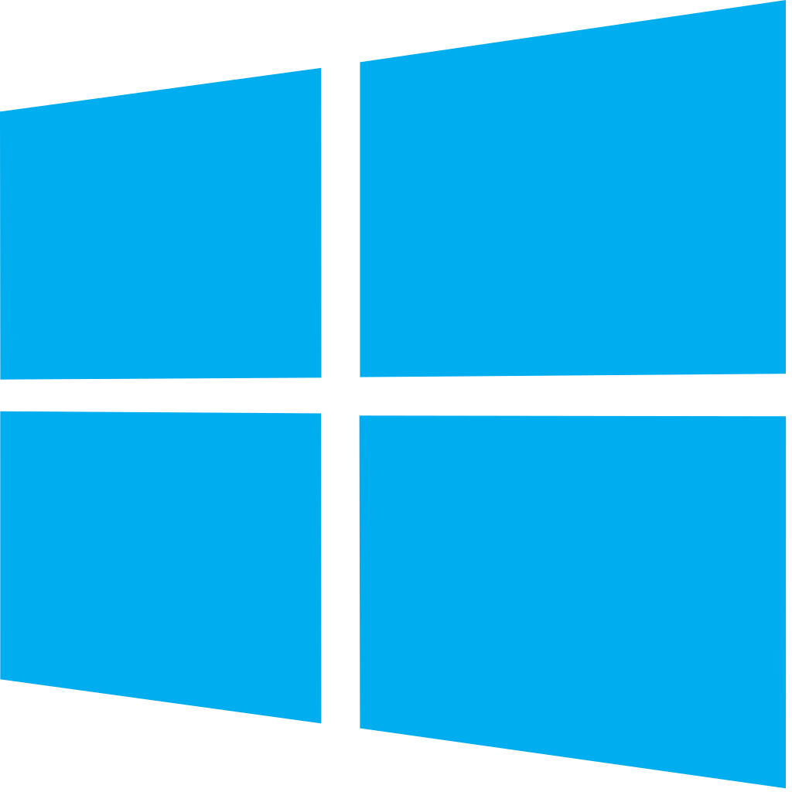
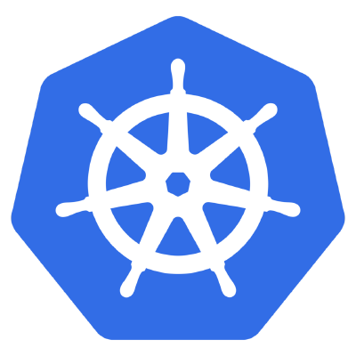

Azure DevOps: Choose what you love
Your tools, languages, and clouds
Azure DevOps lets developers choose the tools and languages that are right for them
Mix and match to create workflows with tools from Microsoft, open source or your favorite 3rd party tools
Target any cloud, on-prem or both and deploy to the servers you need

Slide 7
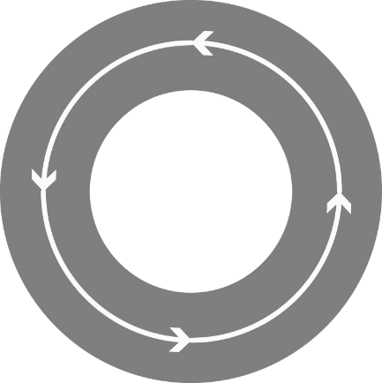
What is DevOps?
People. Process. Technology.
DevOps is the union of people, process, and technology to enable continuous delivery of value to your end users.
“
Plan & Track
Agile Planning
Dashboards
Kanban Boards
Task boards
Build & Test
Git Source Control
Modern Code Workflow
Continuous Integration
Continuous Testing
Package Management
Open Source Compliance
Develop + Test
Plan + Track
Continuous
Delivery
Monitoring & Operations
Telemetry
Diagnostics
Analysis
Compliance
Release
Deployment
Deployment of app and infrastructure
PaaS, IaaS and Containers
Monitor + Operate
Notes:
DevOps es la unión de personas, procesos y tecnología para permitir la entrega continua de valor a sus usuarios finales.

Slide 8
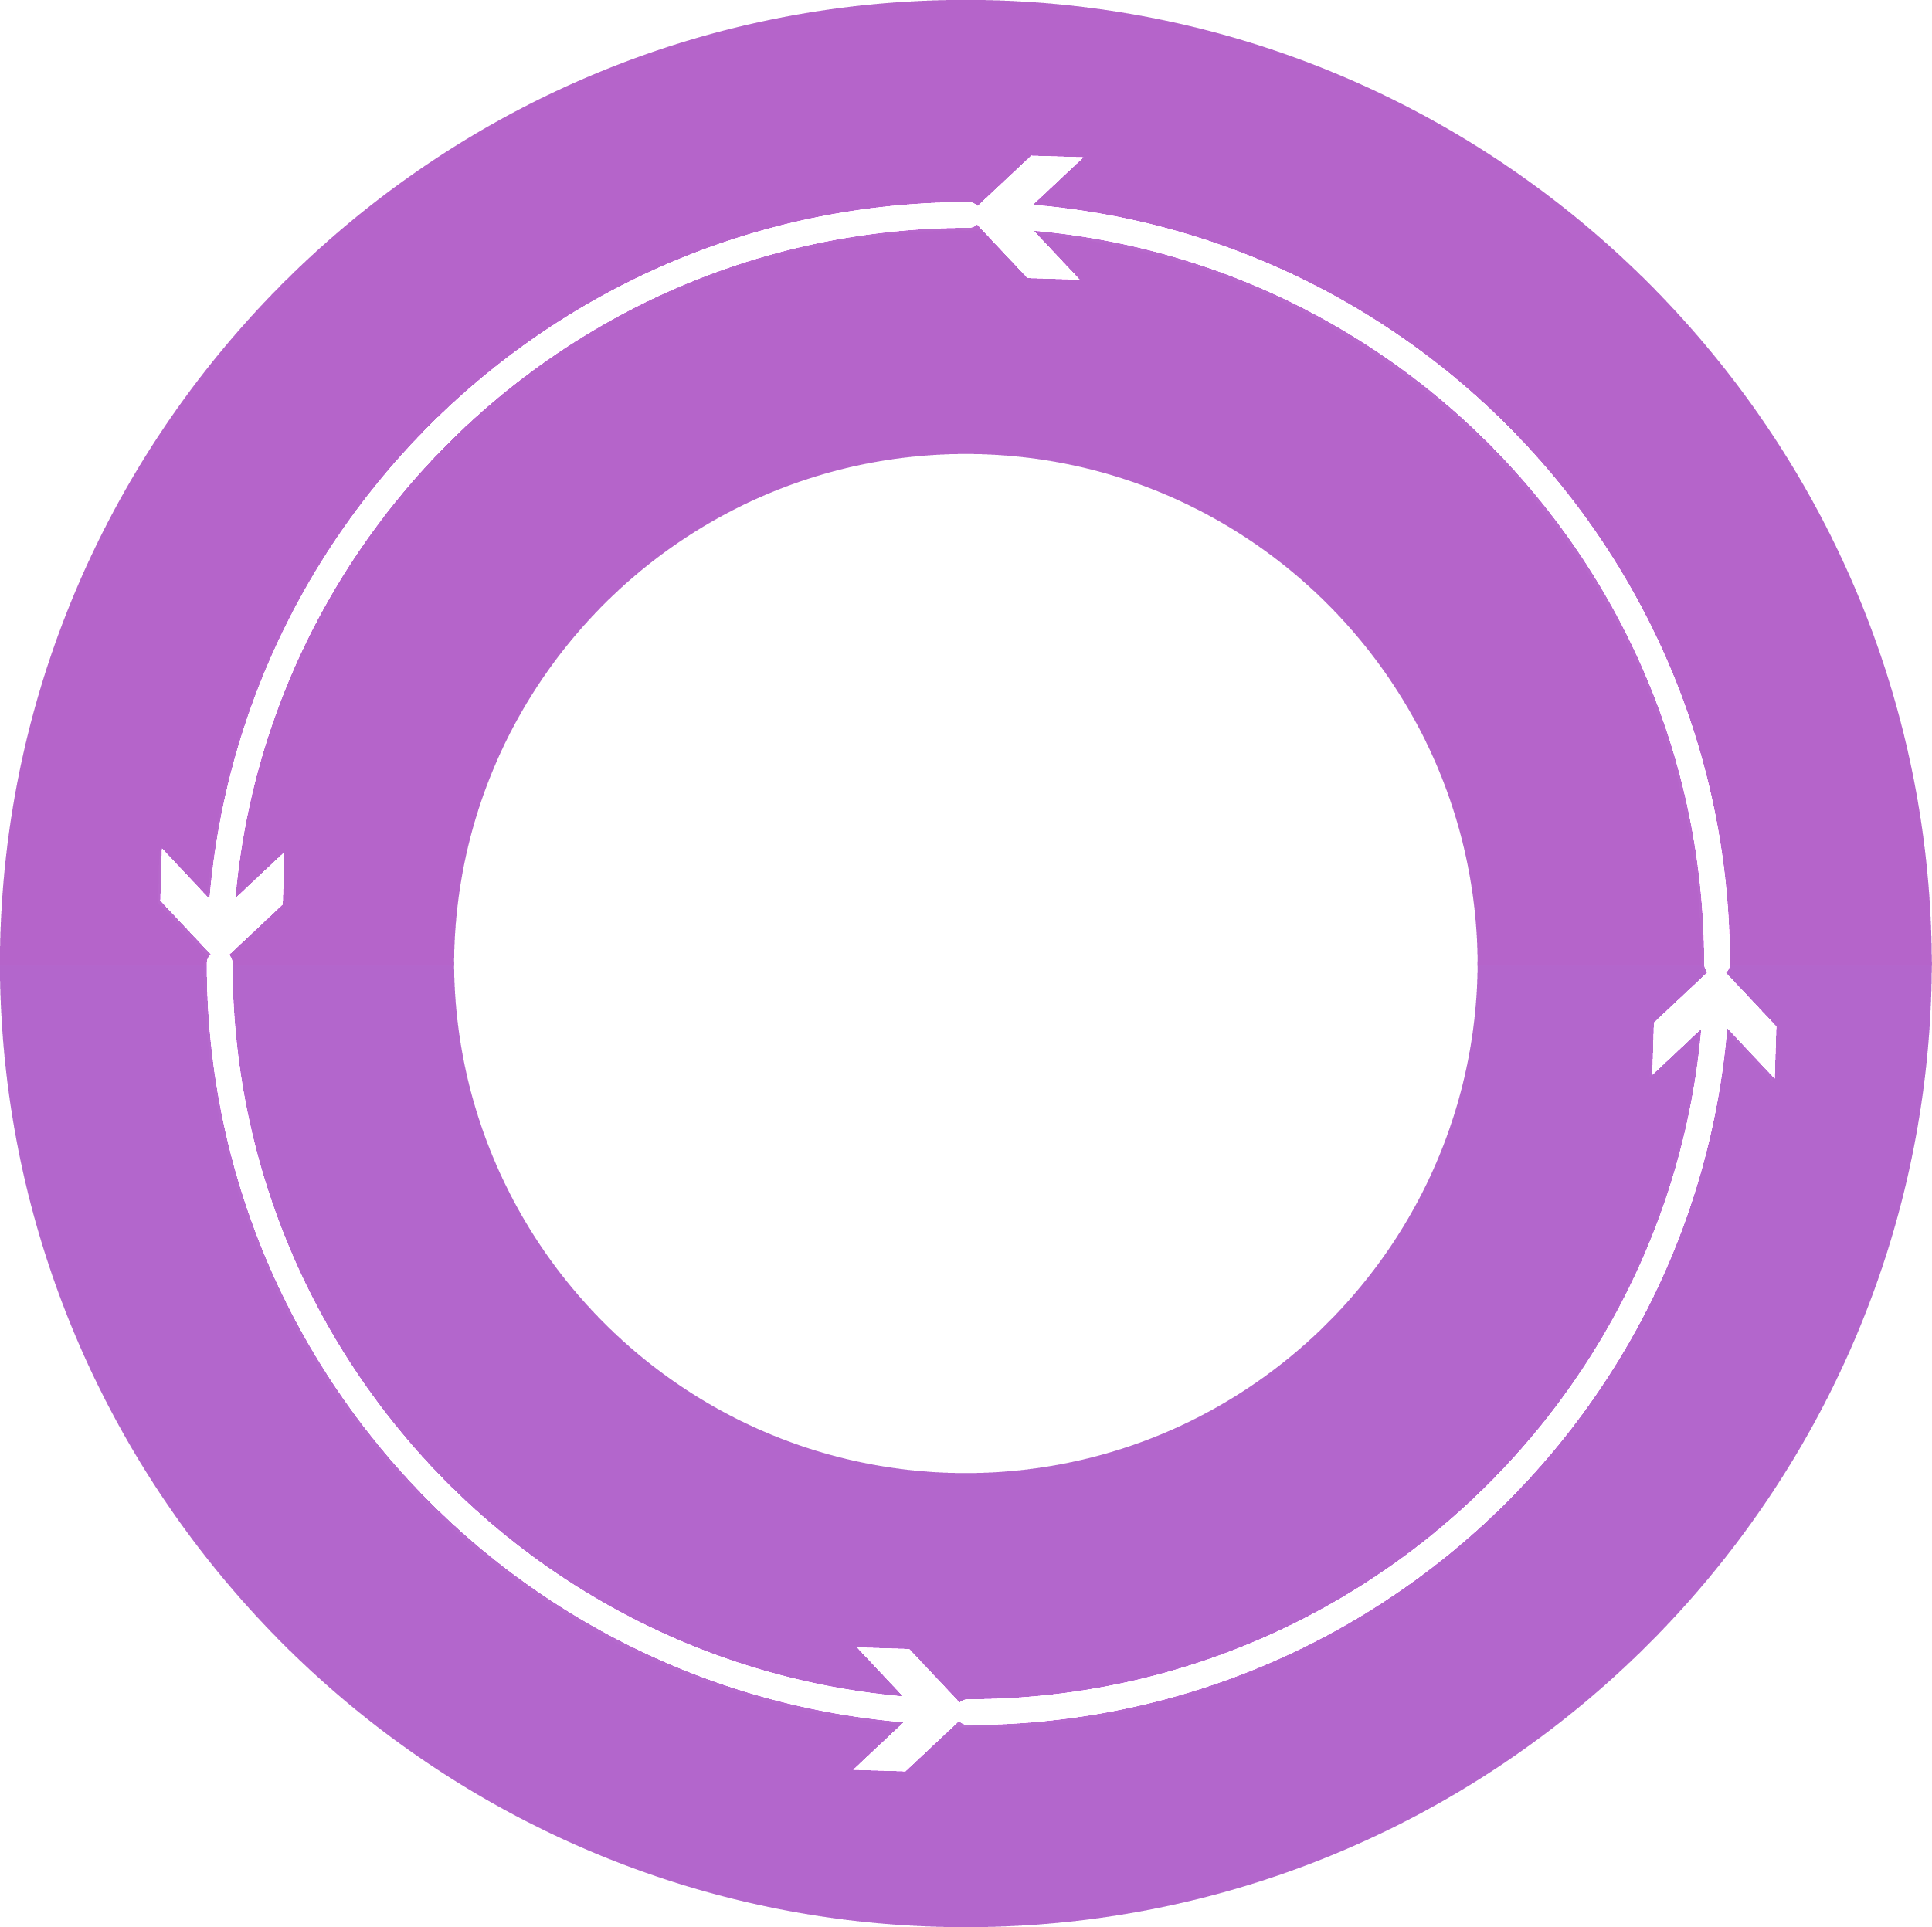



DevOps
1
4
Plan
Monitor + Learn
Development
Production
2
3
Develop + Test
Release

Slide 9
Plan
It starts with an idea – and a plan how to turn this idea into reality …
Project starts
Manage work
Develop + Test
1
Track progress
Plan

Slide 10
Develop + Test
Once the iteration starts, developers turn great ideas into features …
2
Write Code
Unit Testing
Version Control
Build
Build Verification
Release

Slide 11
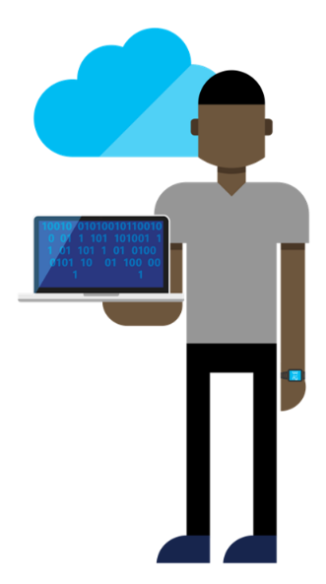

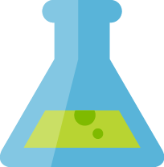
Continuous Integration
Source
Build
Value
Accelerate Delivery
Repeatability
Optimized Resources
Test
Measure
More frequent releases
MTTR
MTTD
DEV
OPS
OPS

Slide 12
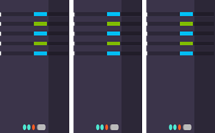
Release
When all tests pass, the build is deployed to testing environments for each stage in the release process
Cloud Load Testing
Integration testing
environment
Staging
environment
3
Monitor + Learn
Automated functional testing environment
Pre-production environment

Slide 13
Release Management
SOURCE REPO
DEV
Value
Optimized Resources
Accelerate Delivery
STAGE
Measure
Deployment Rate
MTTR
Availability
PRODUCTION
DEV
OPS
Notes:
David Note: Make sure to highlight customer pain points, “bullet train”, Poll??

Slide 14
Monitor + Learn
Learn and understand how users use your app, how it reacts and quickly fix issues and bugs
Plan the next iteration
Feedback
Monitor
4

Slide 15
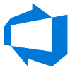





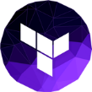
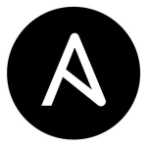


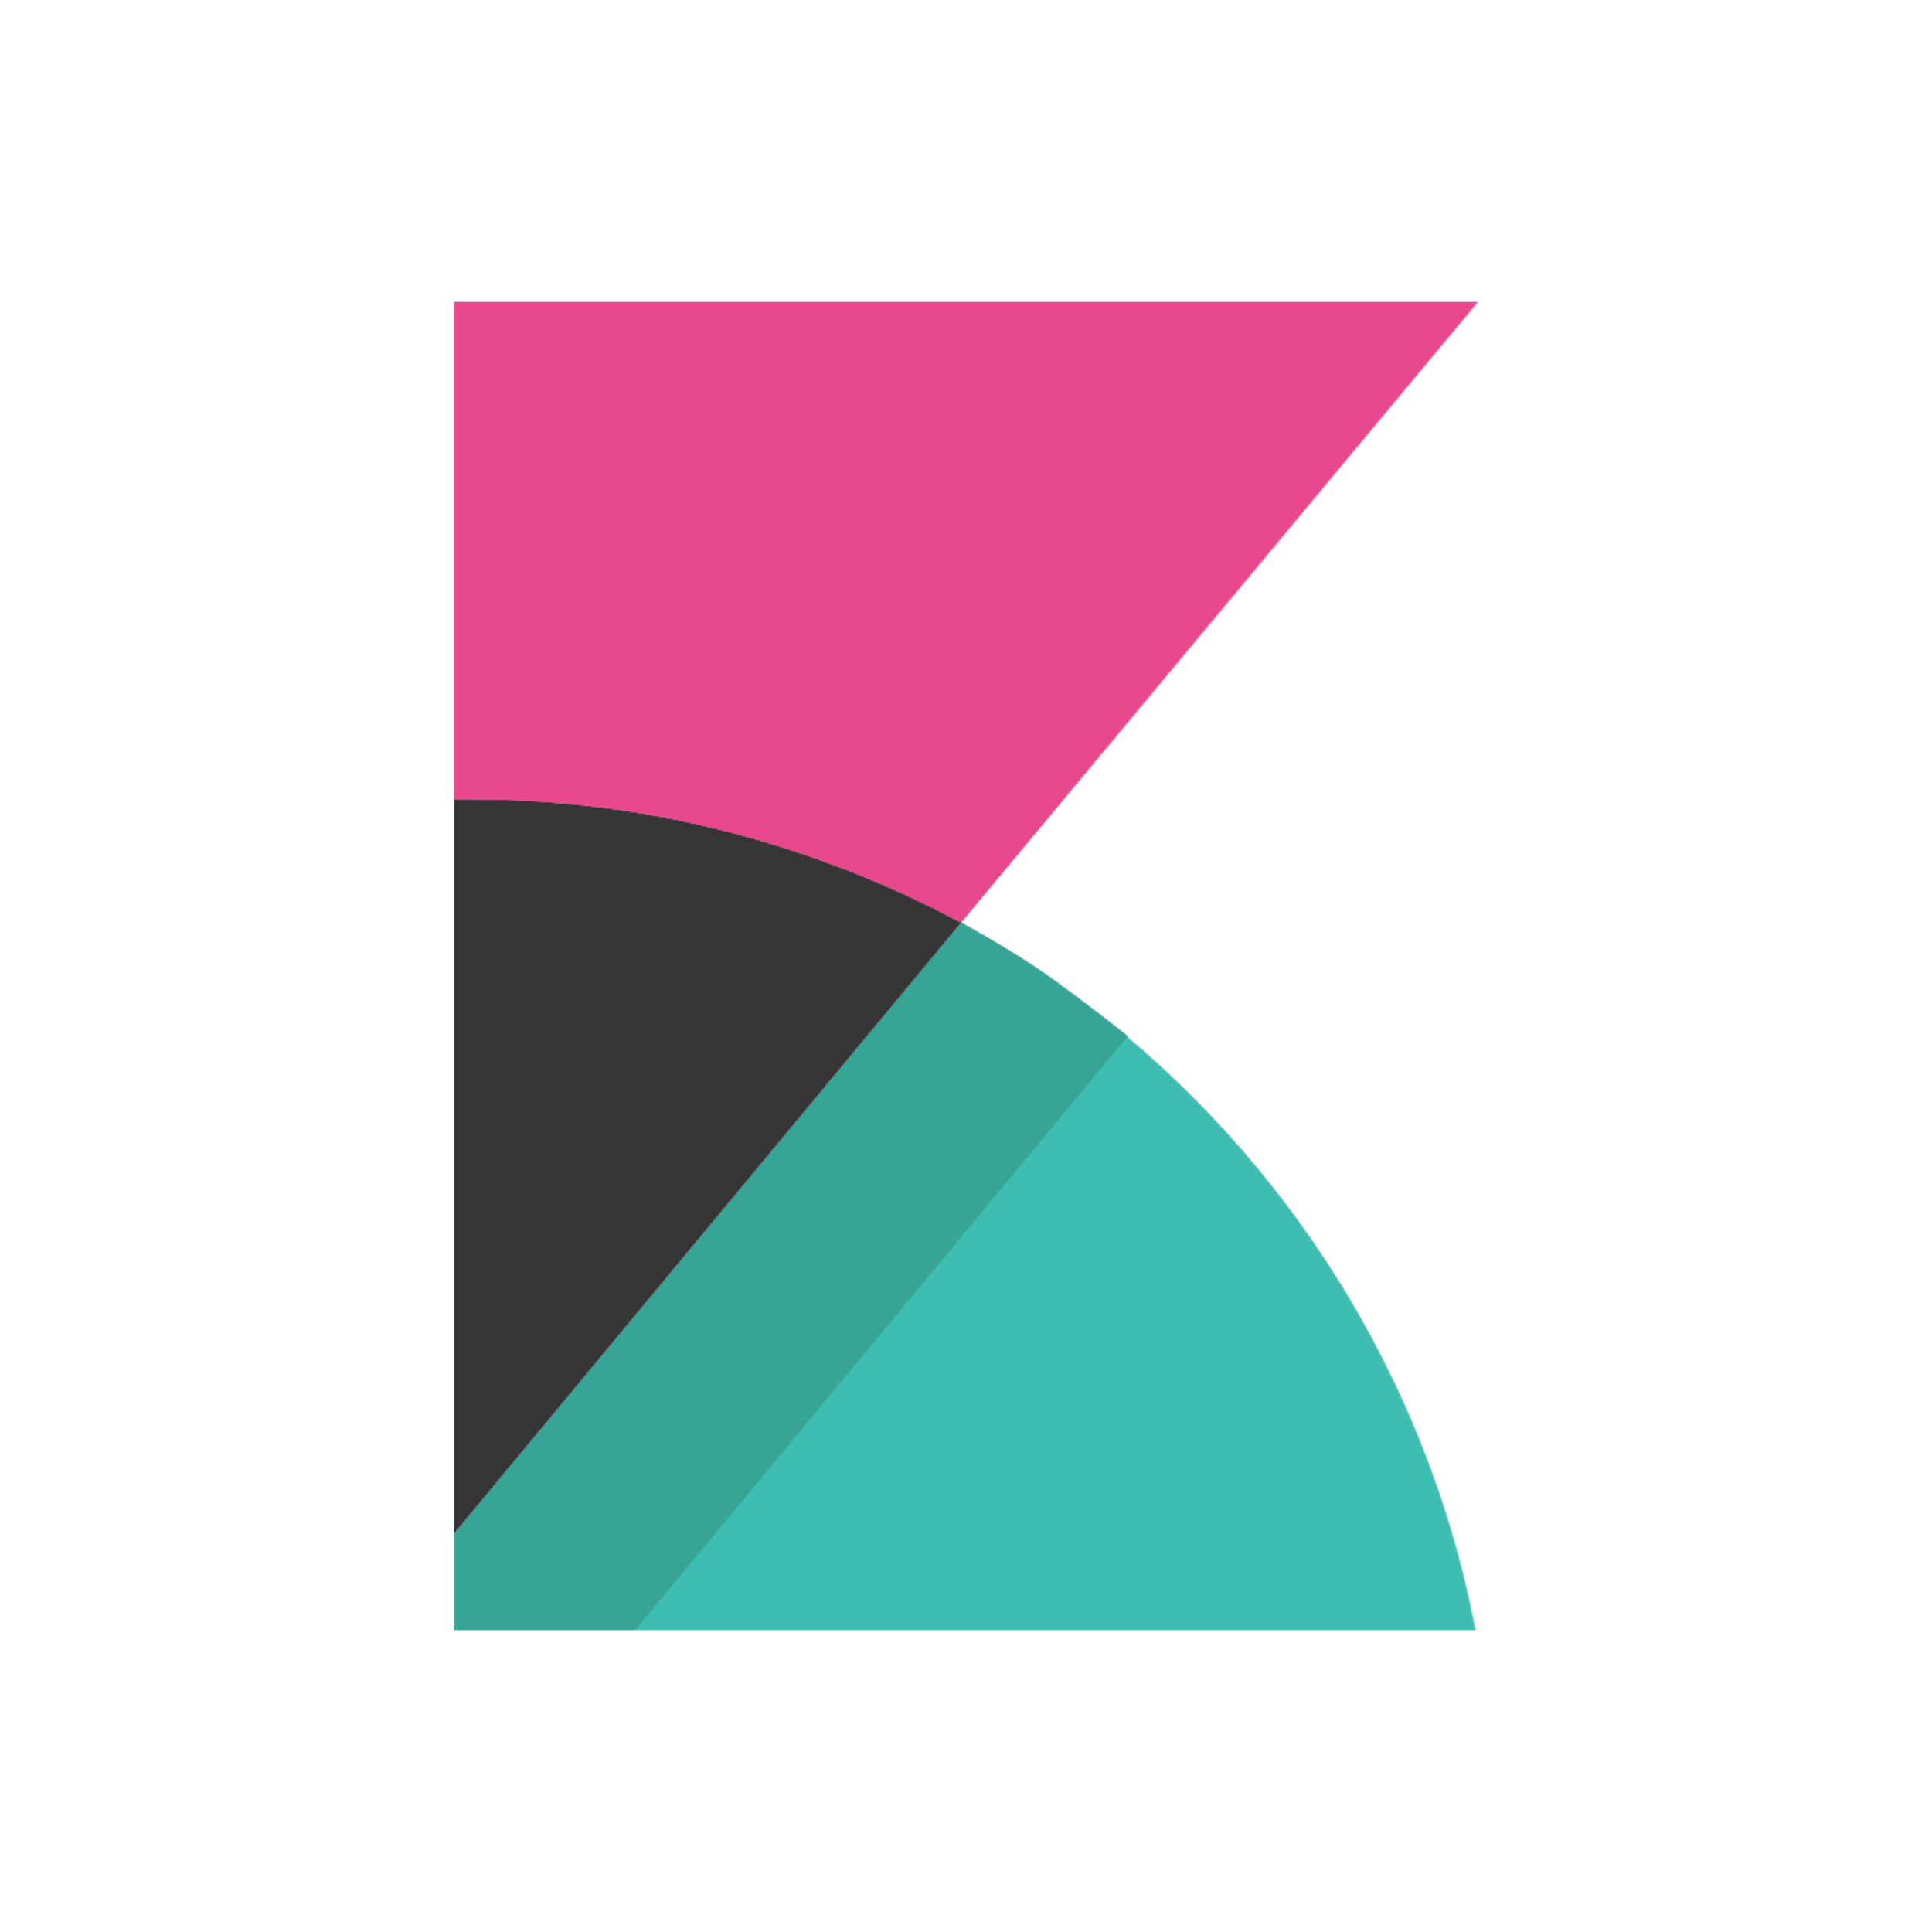
Azure DevOps framework
Plan and track
Code
Build and test
Deploy
Operate
Monitor
Azure Boards
Azure Repos
Azure Pipelines
Azure Pipelines
Key Vault
Application
Insights
Trello
GitHub
Jenkins
Terraform
Ansible
ELK Stack

Slide 16

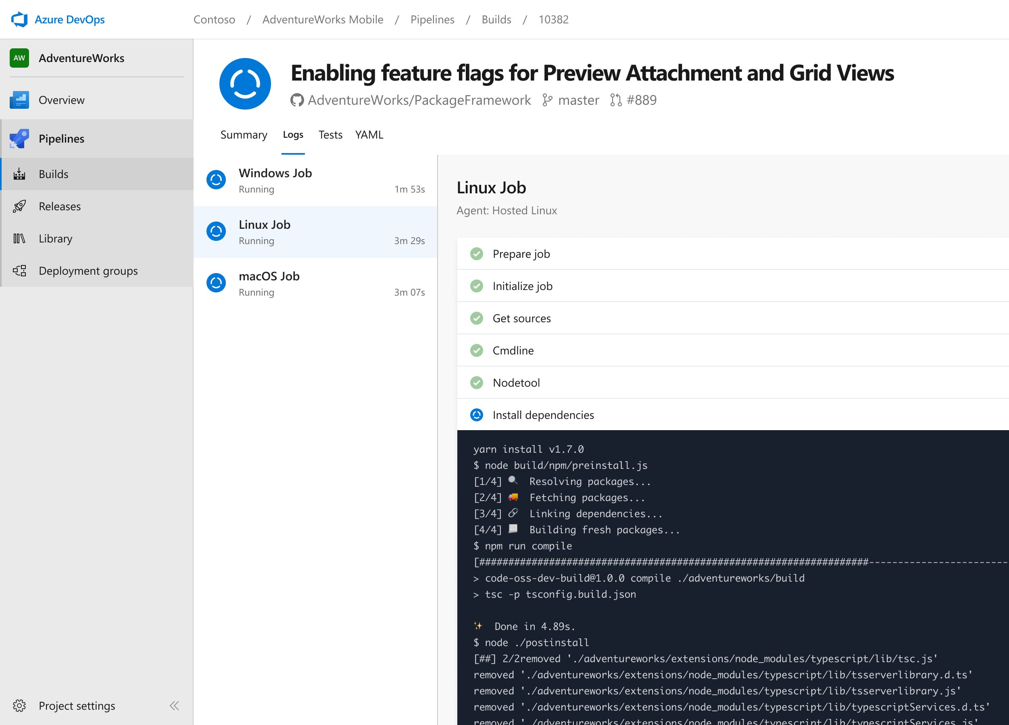


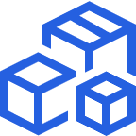

Azure Pipelines
Cloud-hosted pipelines for Linux, Windows and macOS, with unlimited minutes for open source
Any language, any platform, any cloud
Build, test, and deploy Node.js, Python, Java, PHP, Ruby, C/C++, .NET, Android, and iOS apps. Run in parallel on Linux, macOS, and Windows. Deploy to Azure, AWS, GCP or on-premises
Extensible
Explore and implement a wide range of community-built build, test, and deployment tasks, along with hundreds of extensions from Slack to SonarCloud. Support for YAML, reporting and more
Containers and Kubernetes
Easily build and push images to container registries like Docker Hub and Azure Container Registry. Deploy containers to individual hosts or Kubernetes.
Best-in-class for open source
Ensure fast continuous integration/continuous delivery (CI/CD) pipelines for every open source project. Get unlimited build minutes for all open source projects with up to 10 free parallel jobs across Linux, macOS and Windows

Slide 17
Hybrid DevOps Pipeline - Architecture

Slide 18
Hybrid DevOps Pipeline - Architecture
Code
Use Visual Studio or Visual Studio Code
Synchronize Repositories to Dev env
Define Infra for app using ARM templates
Maintain code for Application separately

Slide 19
Hybrid DevOps Pipeline - Architecture
Build
Build Agent hosted in Azure
Set up for Continuous Integration

Slide 20
Hybrid DevOps Pipeline - Architecture
Release to Azure
Create/Update Web App Infra on App Svcs through ARM template on Azure
Publish code to Web App

Slide 21
Hybrid DevOps Pipeline - Architecture
Release to Azure Stack
Release Agent hosted on-prem
Release Agent has access to Azure Stack
Create/Update Web App Infra on App Svcs through ARM template on Azure Stack
Publish code to Web App

Slide 22
Hybrid DevOps Pipeline - Architecture
Monitor Applications
Use Application Insights in Azure to monitor resources in Azure and Azure Stack

Slide 23
DevOps at Microsoft
Azure DevOps is the toolchain of choice for Microsoft internal engineering with over 90,000 internal users
372k
Pull Requests per month
4.4m
Builds per month
5m
Work items viewed per day
78,000
Deployments per day
2m
Git commits per month
500m Test executions per day
500k
Work items updated per day

Slide 24
GRACIAS!

